Slide 1
Video Games recommendation system
Ali Yassine
Ethan Greene
Edoardo Berardi Vittur

Slide 2

Table of Content
Explanation and visualization of the data
Recommendation system
Evaluation of the results

Slide 3
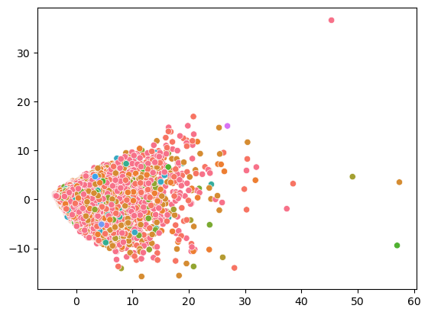
More information about the Steam dataset
71171 games
Find out insights based on the description of the games
Range of release date (from 1997)
PCA on the game from 2017

Slide 4
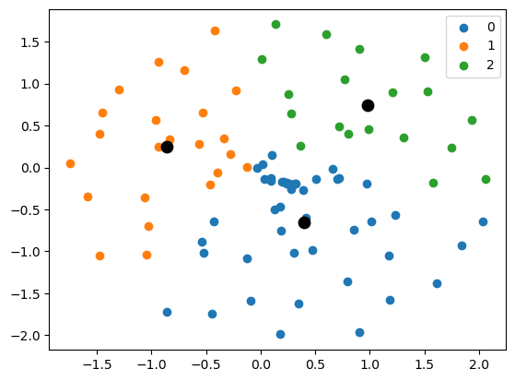
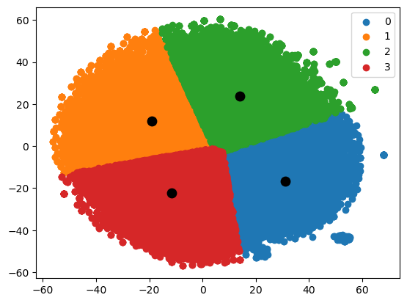
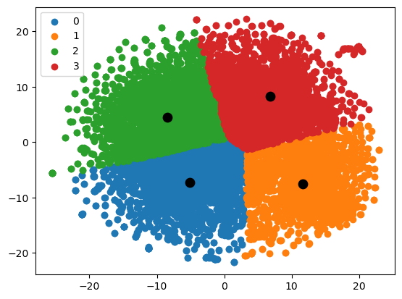
TSNE
Games: 2007 - 2017
Games: 1997 - 2007
Games: 2017 - Now

Slide 5
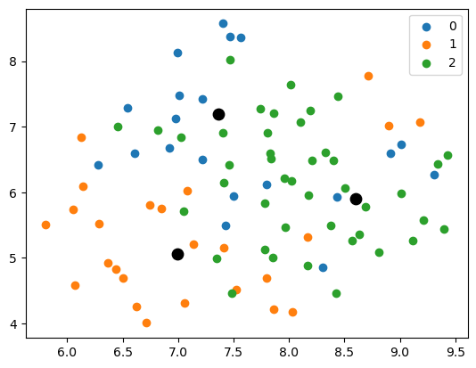
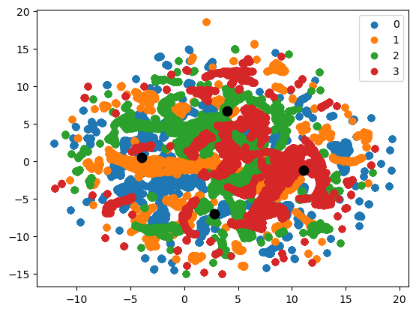
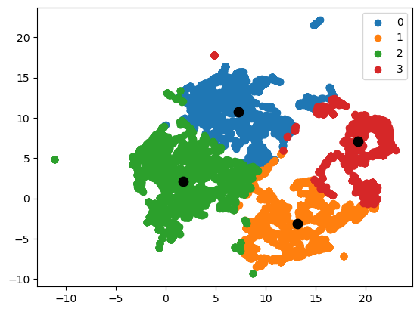
UMAP
Games: 2007 - 2017
Games: 1997 - 2007
Games: 2017 - Now

Slide 6
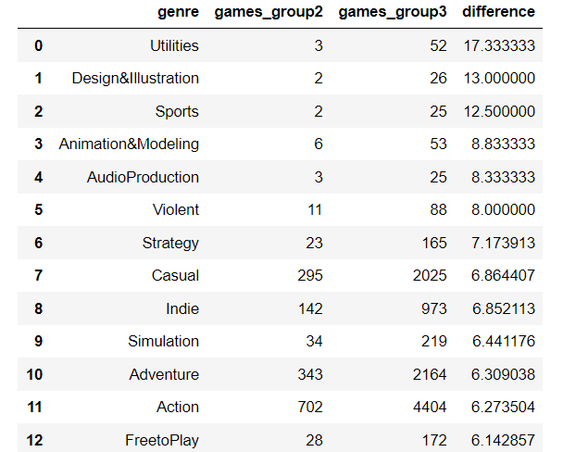
Trends from 2007 to now

Slide 7
Recommendation System
-Content Based Recommendation System
-User-History Based Recommendation System
-Compatibility System

Slide 8
Getting Ready
-Combine all relevant text information such as genre, keywords, overview… into one column called “Tags”
- Using CounterVectorizer, we created a matrix where each word is a feature and each game has a 1 or 0 according to if the Tags of the game contain this word or not respectively.
-Apply PCA

Slide 9
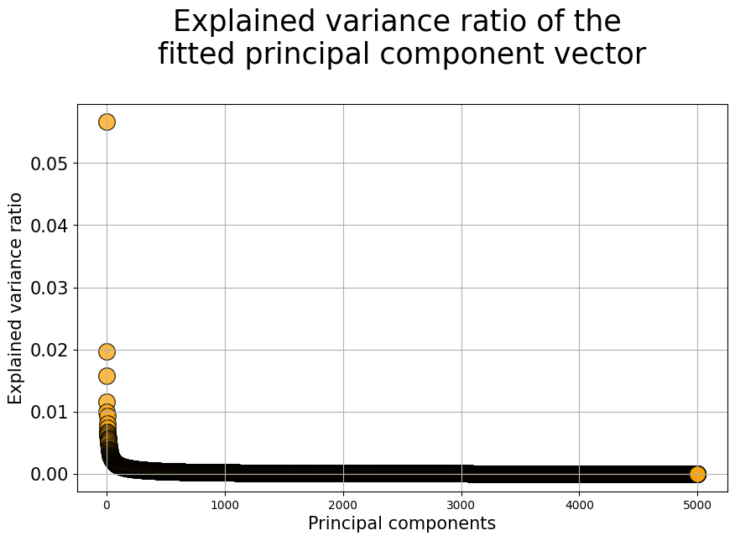

Slide 10
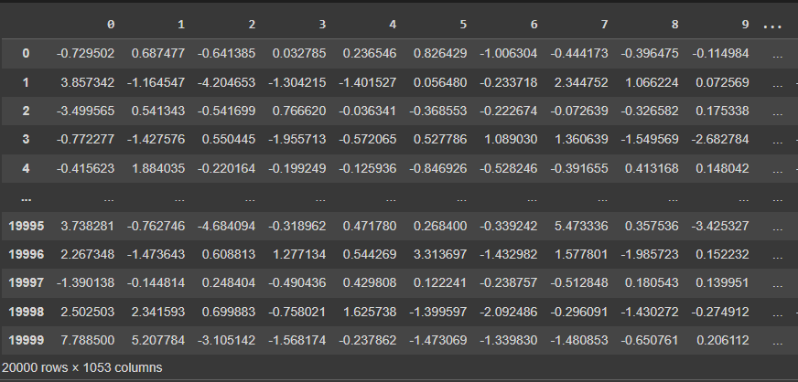

Slide 11
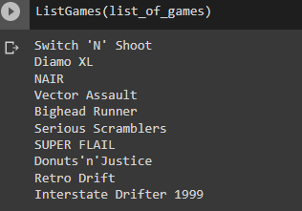
Content Based Recommendation System
-Switch location of user Input to first row of the dataframe
-Compute Cosine Similarity with all other video games
-Get top 10 games with highest similarity

Slide 12
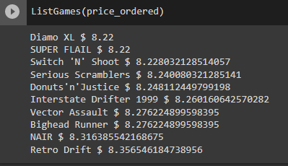
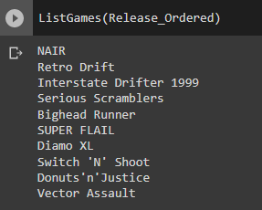
Content Based Recommendation System
-Order the top 10 games according to price in ascending order
-Order the top 10 games according to release date

Slide 13
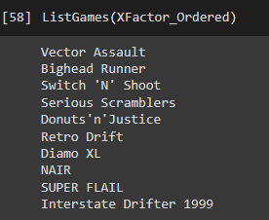
Content Based Recommendation System
-Order the top 10 games according to the XFactor
-Xfactor=Positive score+user score+recommendation score

Slide 14
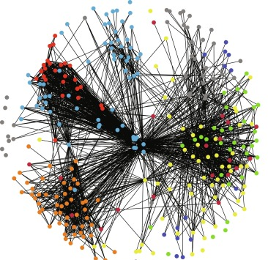
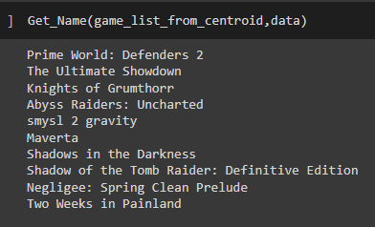
User-History Based Recommendation System
-Create a user history matrix
-Get the centroid of this matrix
- Get the closest games to the centroid
User Space

Slide 15
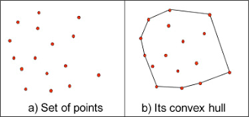
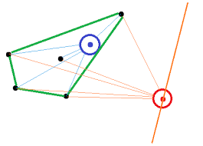
Convex Hull

Slide 16
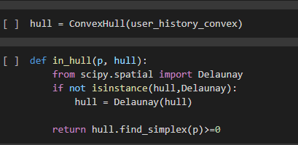
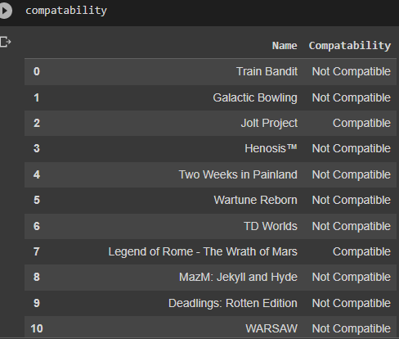
Convex Hull
-Create a convex hull with a user matrix
- Check if games are compatible by checking if they are inside the convex hull or not

Slide 17
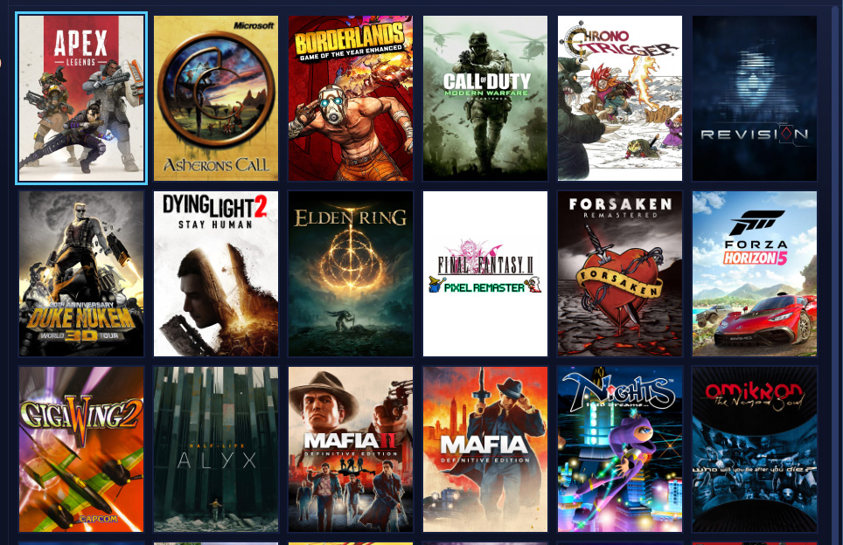



Slide 18
Grading our recommendations

Slide 19
Prepping for calculations
Standardize data to go into perspective calculation functions
Split data into two groups; train and test
Analyze use case!

Slide 20
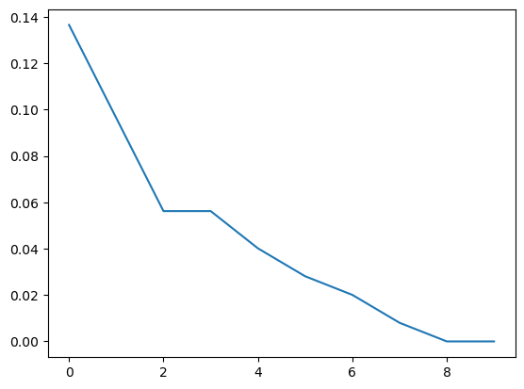
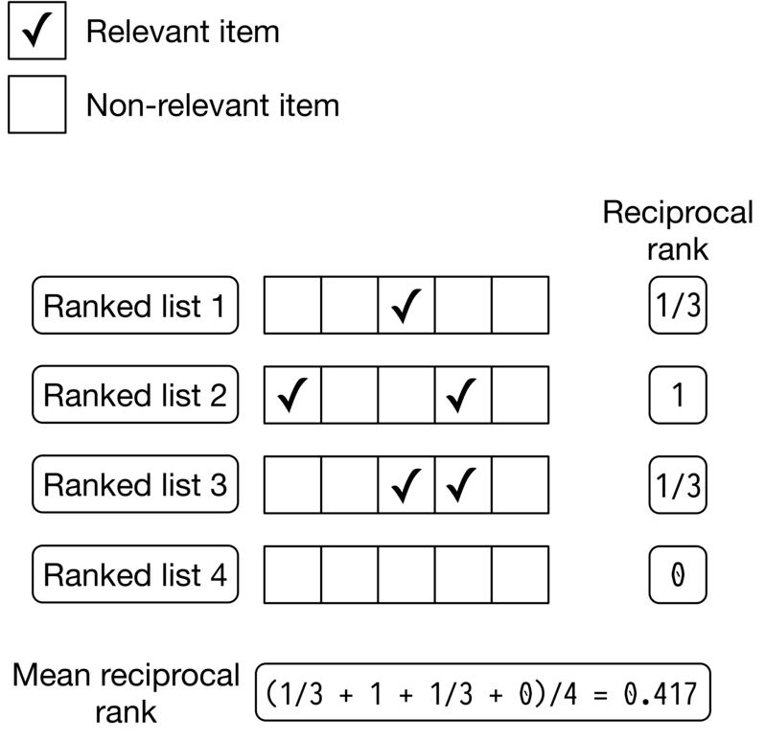
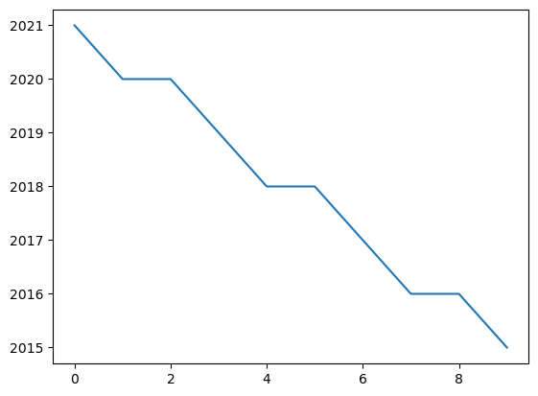
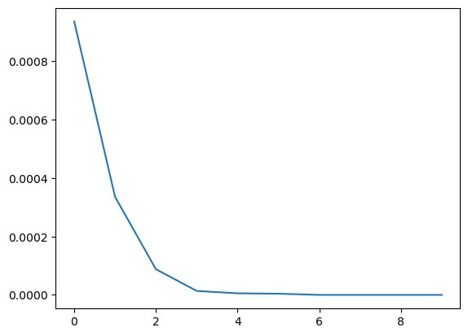
Calculating Mean Reciprocal Rank:
Price-ordered
Release-ordered
XFactor-ordered

Slide 21
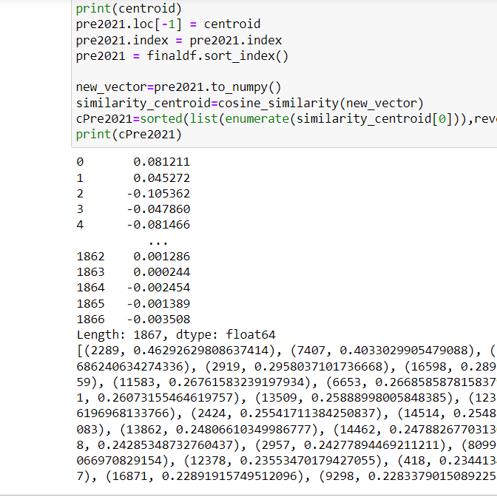
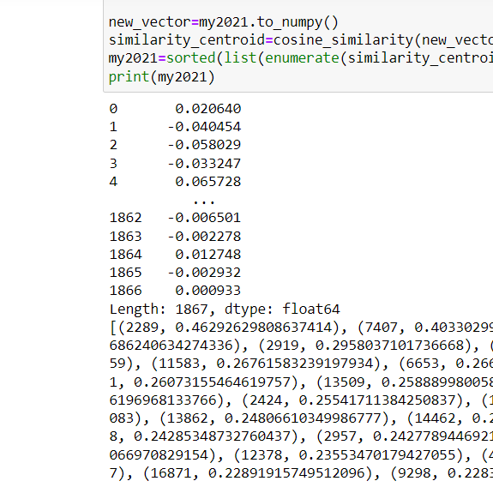
Calculating the different weights for our user over two time periods
Pre 2021
Post 2021

Slide 22
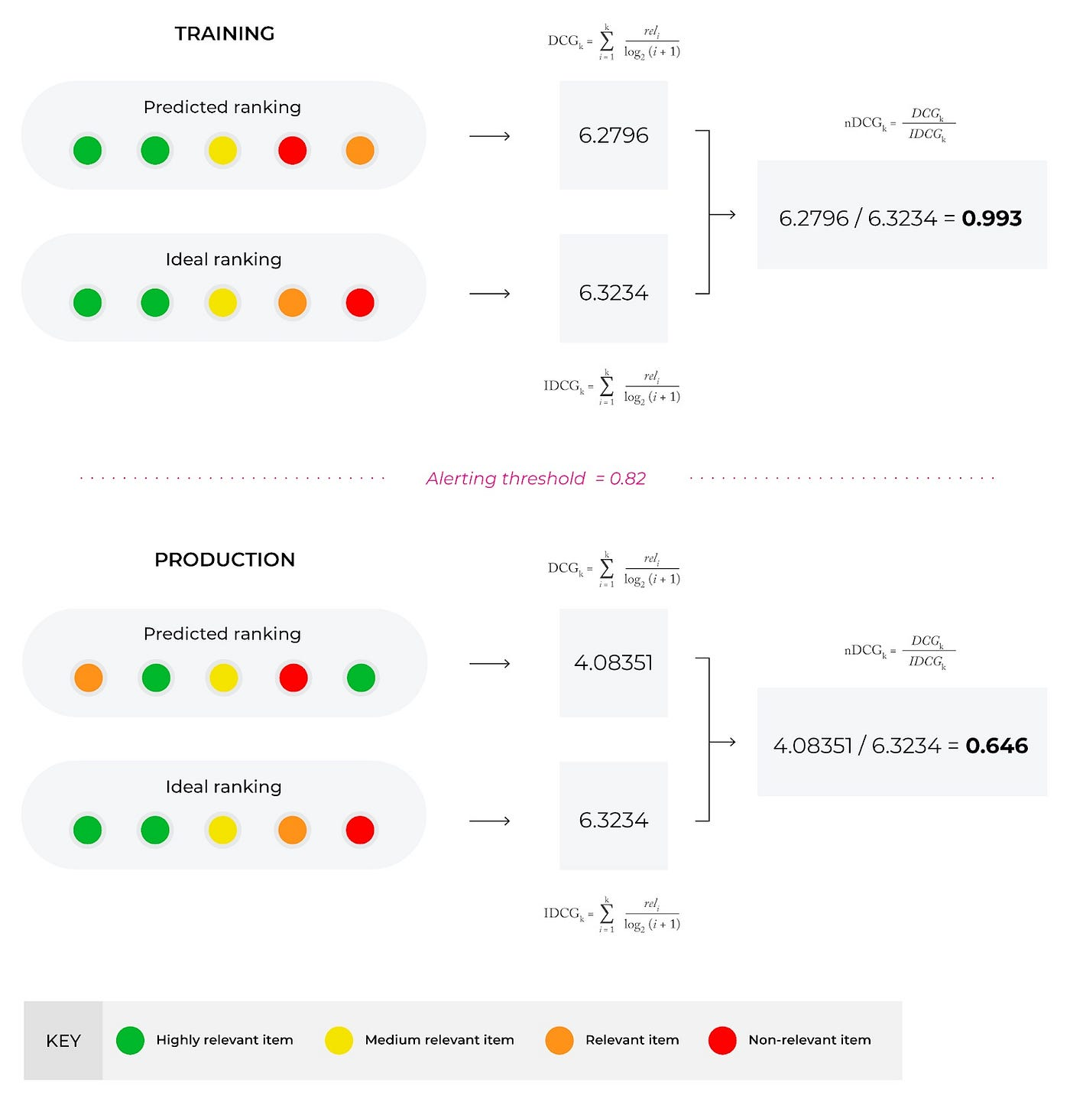
Calculating nDCG on our user recommendations
import math
def calcNDCG(scores1, scores2):
DCG = 0
IDCG = 0
for i in range(len(scores1)):
DCG += scores1[i] / (math.log2(i + 2))
for i in range(len(scores2)):
IDCG += scores2[i] / (math.log2(i + 2))
print(DCG)
return DCG / IDCG
calcNDCG(pre2021[2], my2021[2])
1.0

Slide 23
Real life use cases!!
With online testing we are able to develop:
Recommend video games to customers
Standardize trends in a way we can benefit game development

Slide 24
Thank You !

